Slide 1
ZARILOGISTICS

Slide 2
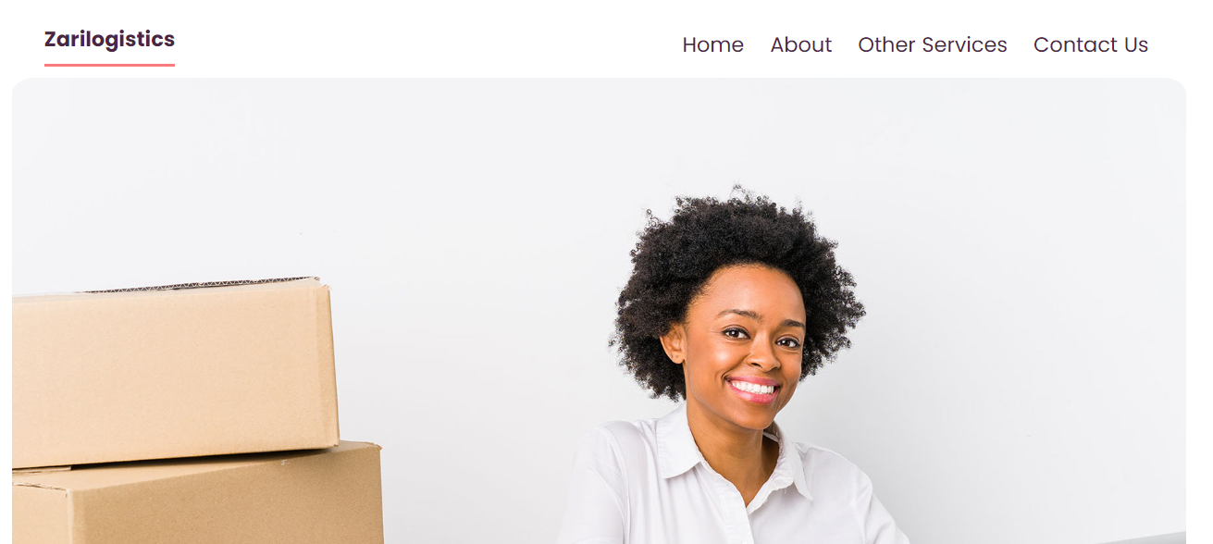
HOME: PAGE

Slide 3
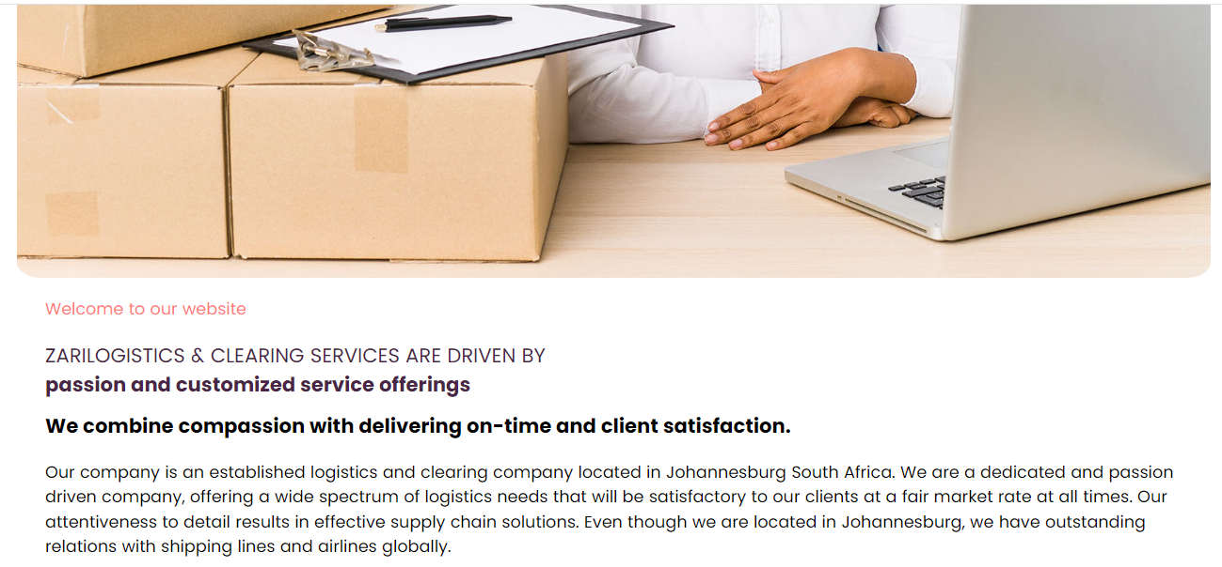
HOME: PAGE

Slide 4
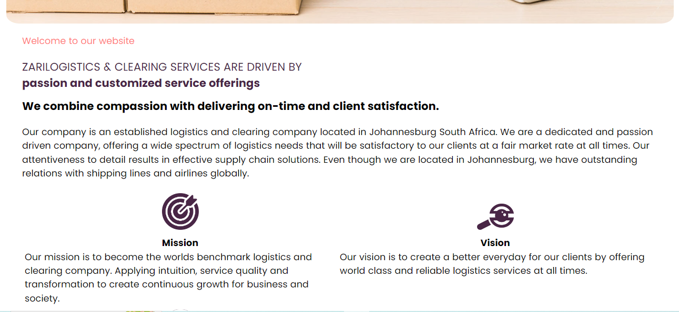
HOME: PAGE

Slide 5
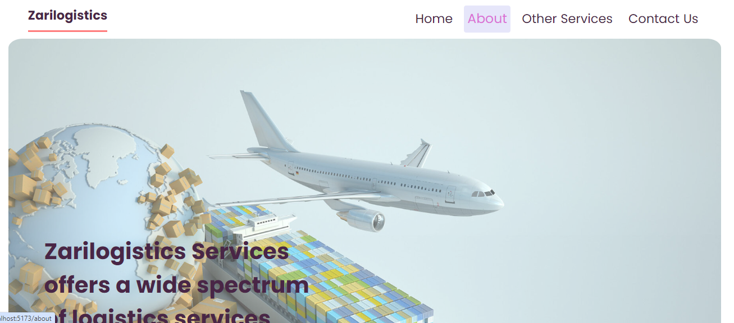
ABOUT US: PAGE

Slide 6
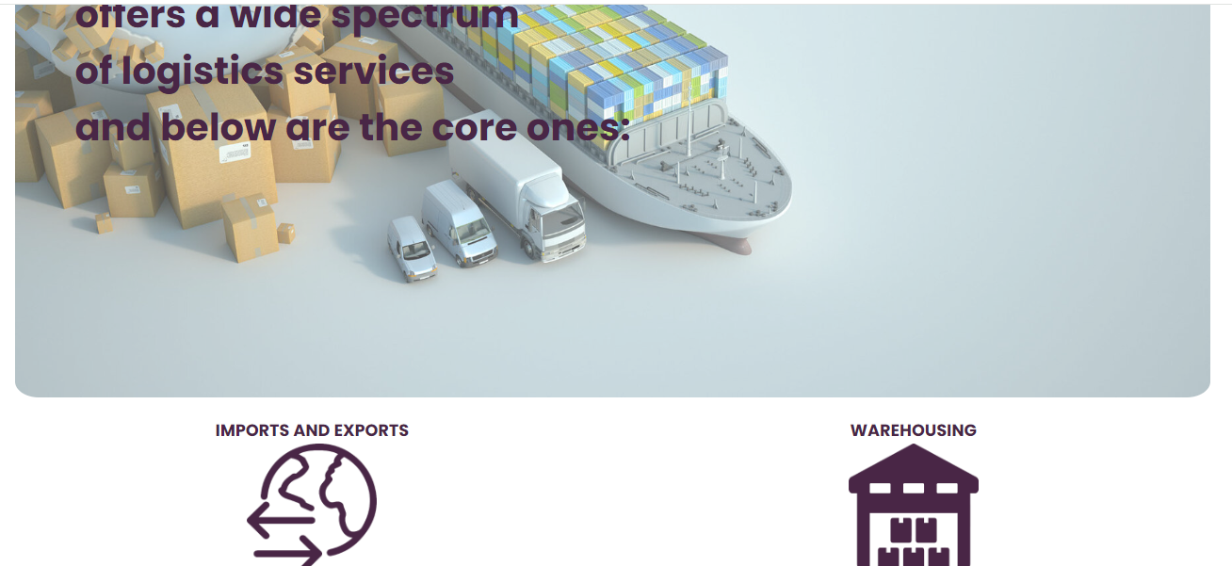
ABOUT US: PAGE

Slide 7
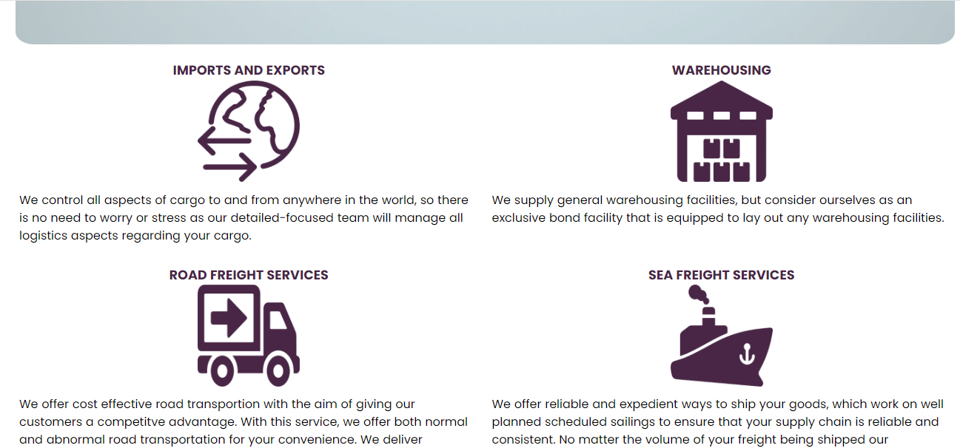
ABOUT US: PAGE

Slide 8
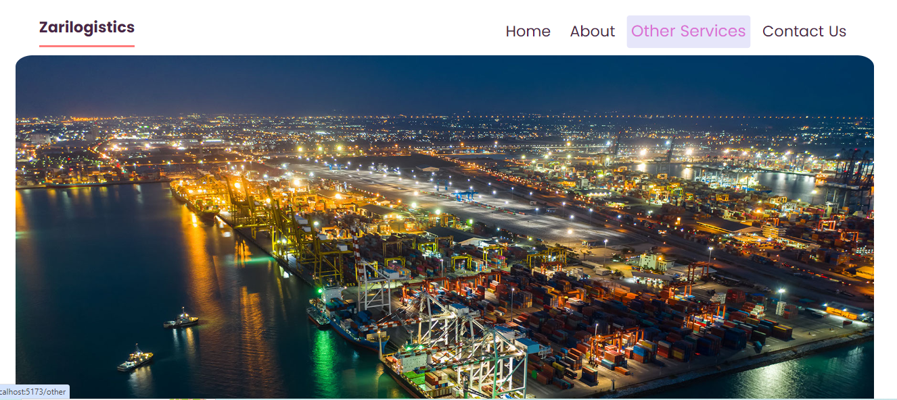
OTHER SERVICES: PAGE

Slide 9
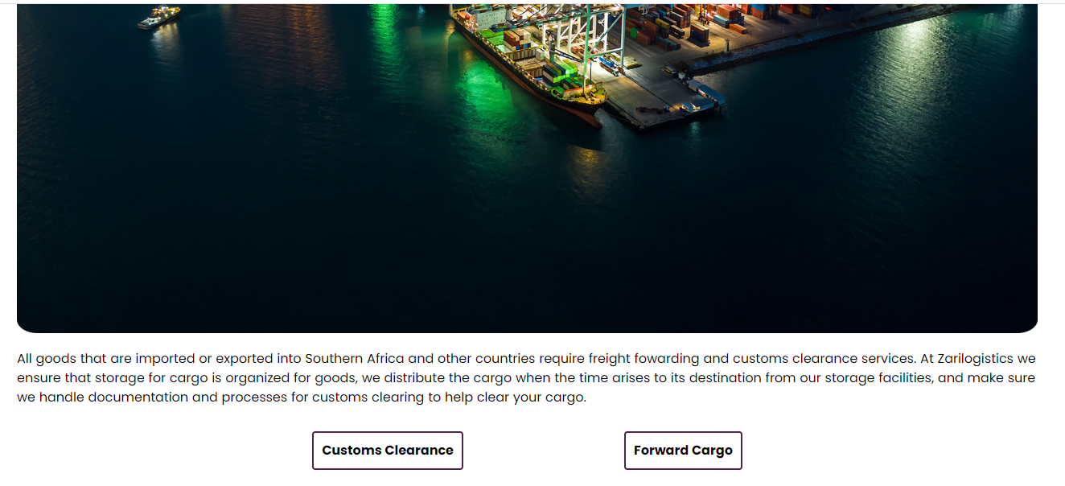
OTHER SERVICES: PAGE

Slide 10
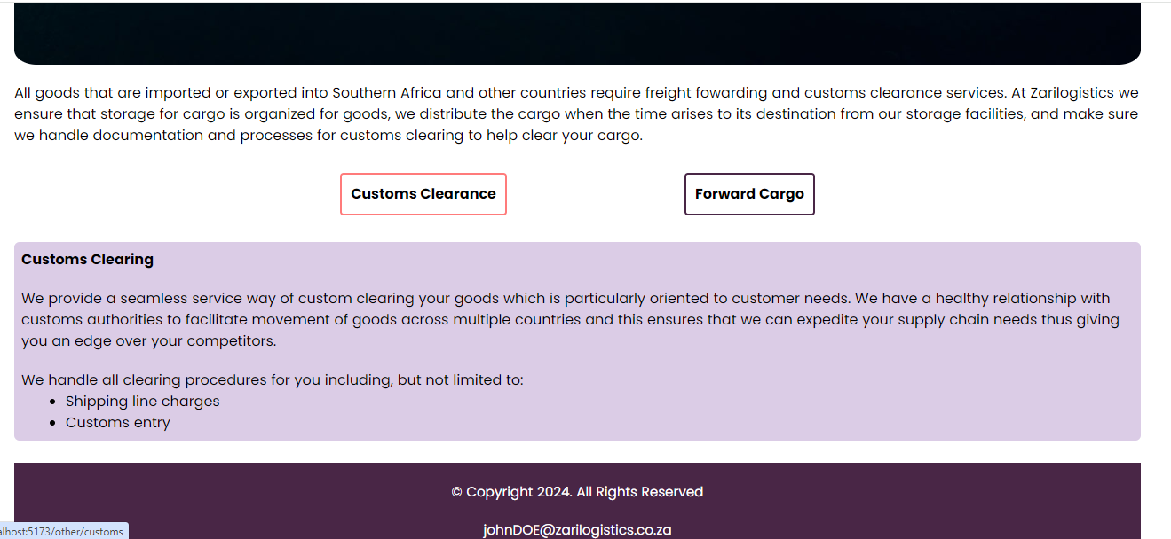
OTHER SERVICES: Nested PAGE A

Slide 11
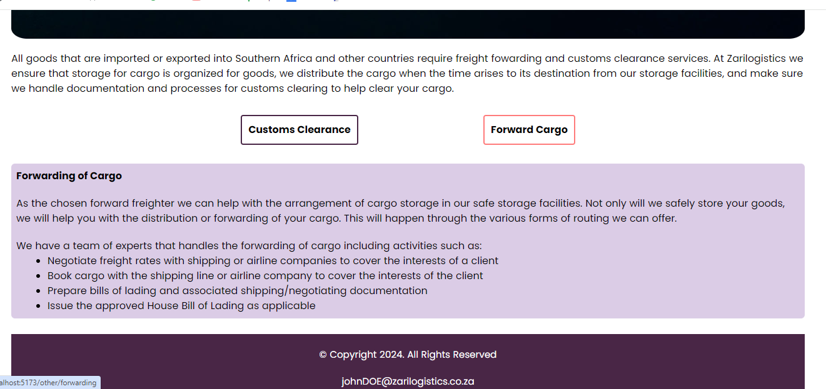
OTHER SERVICES: Nested PAGE B

Slide 12
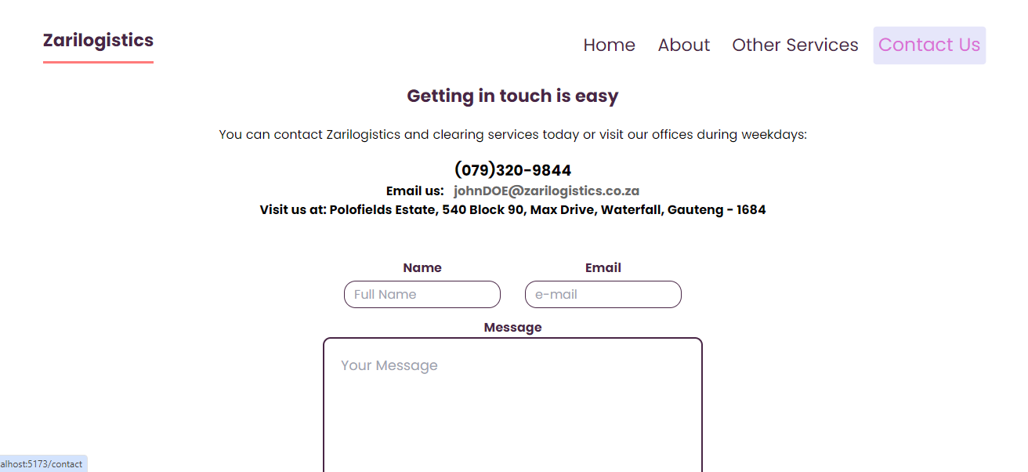
CONTACT US: PAGE

Slide 13
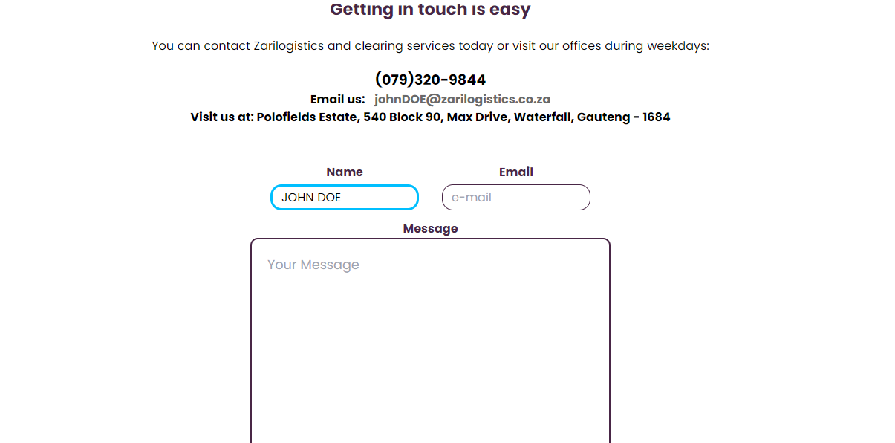
CONTACT US: PAGE

Slide 14
THANK YOU

